Slide 1
Project Practice 1 :
Web Browser Extensions for Data Extraction
Louis Rives-Lehtinen, 2024
xrives00
Supervisor: Burget Radek, doc Ign., Ph.D.

Slide 2

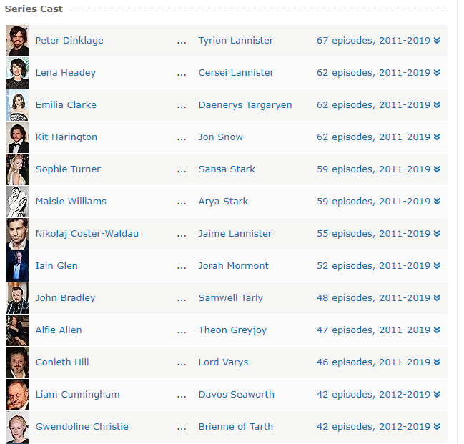
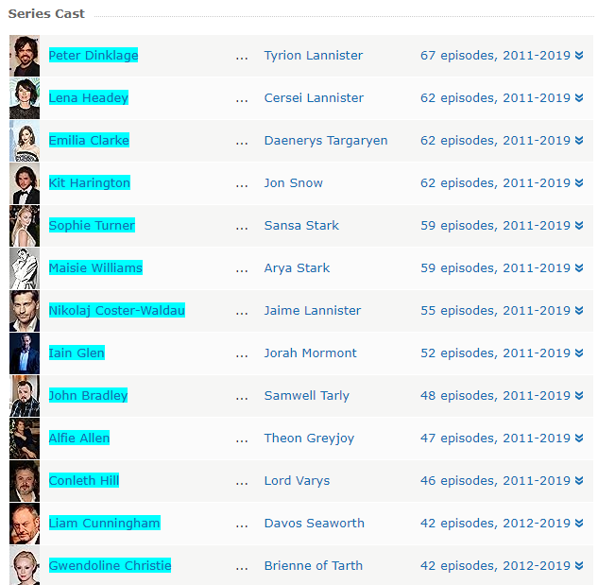
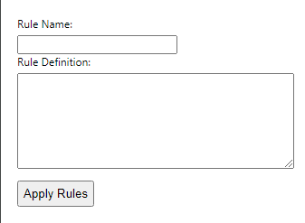
Key Features
Simple and intuitive popup for rule definition.
Users can easily specify rule names and corresponding definitions.
Real-time application of rules to selected webpage content.
Immediate feedback on the modified elements.
The Extension works with any CSS Selector rule definition, on any webpage that allows it.
Technologies used : html, css, javascript

Slide 3
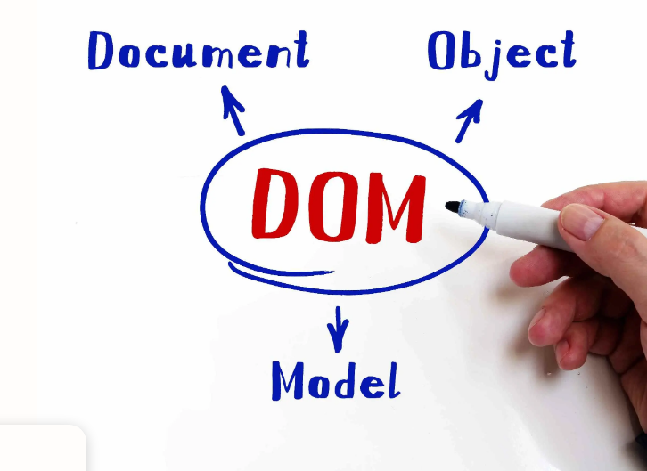
Problems dealt with :
-Accessing the DOM
From this point, everything was new to me, so I had to do some research.
-Editing the DOM :
I lost a lot of time trying to edit the DOM before I was missing the « .trim() » function to remove whitespace. The first definition was working but not the second one.

Slide 4

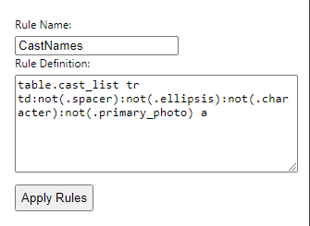
Possible upgrade:
Instead of using CSS selector in my rule definition I could propose my own simple syntax, so users could employ a simplified syntax:
*[font-size: 12, color: black] *[cast_list.position.y > producer.position.y]

Slide 5

Conclusion
This project was not only enjoyable but also an enriching learning experience. The exploration of extensions, DOM manipulation, and CSS selectors provided insights into the intricacies of web development. Through overcoming challenges and implementing real-time changes, I developed my ability to create a user-friendly tool for dynamic DOM modification. This project served as a stepping stone in my journey of growth in the dynamic world of web technologies.

